Slide 1


Yelp Restaurant Star Rating Prediction
Zi Leng Chua, Anh Nguyen, Jiacheng Yu ​

Slide 2
Agenda
Problem Statement | 3
Background Information | 4
Contribution | 5
Data Description | 7
Data Dictionary | 8
Exploratory Data Analysis | 14
Pre-Processing | 28
Model and Evaluations | 41
Discussion and Conclusion | 47

Slide 3
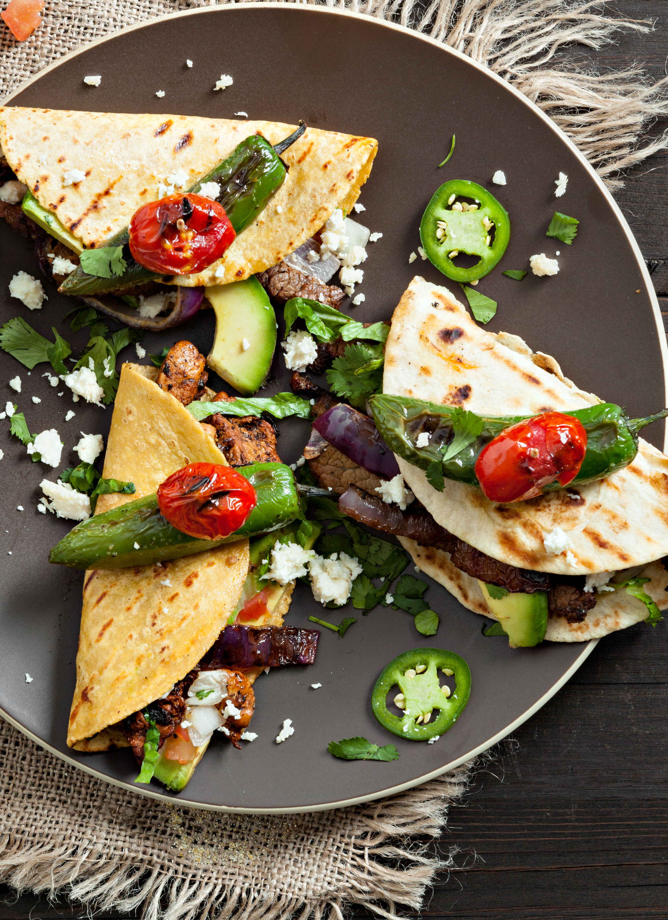
Problem Statement
To predict restaurants’ star rating in Pennsylvania & Florida.

Slide 4
Background Information
67% of customers will consider leaving a review for a positive experience, while 40% will consider leaving a review for a negative experience. And 98% of customers read online reviews for local businesses.
Only 3% of customers said they would consider using a business with an average star rating of 2 or fewer stars.
More consumers use Yelp to evaluate local businesses than ever before. In 2021, 53% did, but the year before that, only 32% did.
All statistics in this page are from Local Consumer Review Survey 2022: Customer Reviews and Behavior (brightlocal.com)

Slide 5
Contribution
Our focus of the study can be widely applied by many food businesses to educate owners on factors that have great influences on their ratings. This can help businesses improve their customer satisfaction and attract new customers.

Slide 6
Process Flow Chart

Slide 7







Business Attributes
Kaggle
Final Dataset
Income
U.S. Census Bureau
Review Text
Cleaned Dataset
Exploratory Data
Analysis (EDA)
Data Sources
Data Preprocessing
Feature Selection
Grid Search
Regression Algorithms
Recommendation
Evaluation
Model Optimization
Supervised Learning
Notes:
I’ll briefly walk over our research process flow chart.
Got dataset from 2 data sources: Kaggle & Census Bureau
To understand about the dataset, we performed EDA
Then preprocessing 3 datasets to get the final cleaned data
In the feature selection, we also remove the high correlation and unwanted data from the final dataset
Ready to perform machine learning modeling using the regression algorithms
To improve the model performance, we also did model optimization using the grid search
Evaluate the models to gain actionable insights and provide business recommendations

Slide 8
Data

Slide 9
Yelp Dataset
Business
Review
User
Tip
Check In

Slide 10

Yelp Dataset
Business
Review
User
Tip
Check In

Slide 11
Data Description
Yelp Dataset:
8 metropolitan areas in the USA and Canada.
6 files including 5 JSON data files and 1 PDF file that is about user agreement.
2020 Census Income Data for PA and FL postal zip codes: (3 columns x 2781 rows)
3 columns:
postal_code: all 5-digit postal zip codes fully/partially contained within PA and FL
Total number of households in the zip code
ACS 5-year estimate average household income of each zip code
Data File | Data Size | Observations | Features
business | 119 MB | 150,346 | 14
check-in | 287 MB | 131,930 | 2
review | 5.34 GB | 6,990,280 | 9
tip | 181 MB | 908,915 | 5
user | 3.36 GB | 1,987,897 | 22
Total Size | 9.3 GB

Slide 12
Data Dictionary
Business Dataset
Name | Description | Valid Domain Values | Data Type | Length | Example Values | Data Attributes | Null Ratio
business_id | Business ID |  | String | 22 | Pns2l4eNsfO8kk83dixA6A | Nominal | 0.00%
name | Business Name |  | String | 66 | Abby Rappoport, LAC, CMQ | Nominal | 0.00%
address | Business Address Street |  | String | 120 | 1616 Chapala St, Ste 2 | Nominal | 0.00%
city | Business Address City |  | String | 50 | Santa Barbara | Nominal | 0.00%
state | Business Address State | State Abbreviations: XX | String | 2 | CA | Nominal | 0.00%
postal_code | Business Address Postal Code | US: XXXXX Canada: | String | 5 | 93101 | Nominal | 0.00%
latitude | Business Address Latitude |  | Float | 14 | 34.426679 | Interval | 0.00%
longitude | Business Address Longitude |  | Float | 14 | -119.711197 | Interval | 0.00%
stars | Star rating, rounded to half-stars | Ranges: 1.0 - 5.0 | Float | 3 | 5.0 | Ratio | 0.00%
review_count | Number of reviews |  | Integer | 4 | 7 | Ratio | 0.00%
is_open | 0 or 1 for closed or open, respectively | 1 = Open 0 = Close | Integer | 1 | 1, 0 | Binary | 0.00%
attributes | Business attributes to values. Note: some attribute values might be objects | {Attribute 1:True/False, Attribute 2:True/False, etc.} | String | 33 | {'ByAppointmentOnly': 'True'} | Nominal | 9.14%
categories | Business Categories | Category 1, Category 2, etc. | String | 503 | Doctors, Traditional Chinese Medicine, Naturopathic/Holistic, Acupuncture, Health & Medical, Nutritionists | Nominal | 0.07%
hours | Key day to value hours, hours are using a 24hr clock | {Day of week: HH:MM-HH:MM} | String | 7 | {'Monday': '0:0-0:0', 'Tuesday': '8:0-18:30', 'Wednesday': '8:0-18:30', 'Thursday': '8:0-18:30', 'Friday': '8:0-18:30', 'Saturday': '8:0-14:0'} | Interval | 15.45%

Slide 13
Data Dictionary
Review Dataset
Name | Description | Valid Domain Values | Data Type | Length | Example Values | Data Attributes | Null Ratio
review_id | Review ID |  | String | 22 | KU_O5udG6zpxOg-VcAEodg | Nominal | 0.0%
user_id | User ID |  | String | 22 | mh_-eMZ6K5RLWhZyISBhwA | Nominal | 0.0%
business_id | Business ID |  | String | 22 | XQfwVwDr-v0ZS3_CbbE5Xw | Nominal | 0.0%
stars | Star Rating | Ranges: 1 - 5 | Float | 3 | 3.0 | Ratio | 0.0%
useful | Number of useful votes received | 0 - 1182 | Integer | 4 | 3 | Ratio | 0.0%
funny | Number of useful funny received | 0 - 792 | Integer | 3 | 4 | Ratio | 0.0%
cool | Number of useful cool received | 0 - 404 | Integer | 3 | 5 | Ratio | 0.0%
date | Reviewed Date | YYYY-MM-DD HH:MM:SS | Date | 10 | 2018-07-07 22:09:11 | Interval | 0.0%
text | Review Text |  | String |  | Super simple place but amazing nonetheless. It's been around since the 30's and they still serve the same thing they started with: a bologna and salami sandwich with mustard. \n\nStaff was very helpful and friendly. | Nominal | 0.0%

Slide 14
Data Dictionary
U.S. Census Income Dataset
Name​ | Description​ | Valid Domain Values​ | Data Type​ | Length​ | Example Values​ | Data Attributes​ | Null Ratio​
full_zip_code​ ​ | Geographic Area Name​ | ZCTA5 ##### ​ | string​ | 11​ | ZCTA5 32133​ | Nominal​ | 0%​
total_hh​ | Estimate Total Households​ | 0 - 31260​ | int​ | 5​ | 11093​ | Nominal​ | 0%​
avg_income​ | Estimate Mean Household Income​ | 13196 - 409434​ | int​ | 6​ | 119164​ | Nominal​ | 4%​

Slide 15
Exploratory Data Analysis

Slide 16
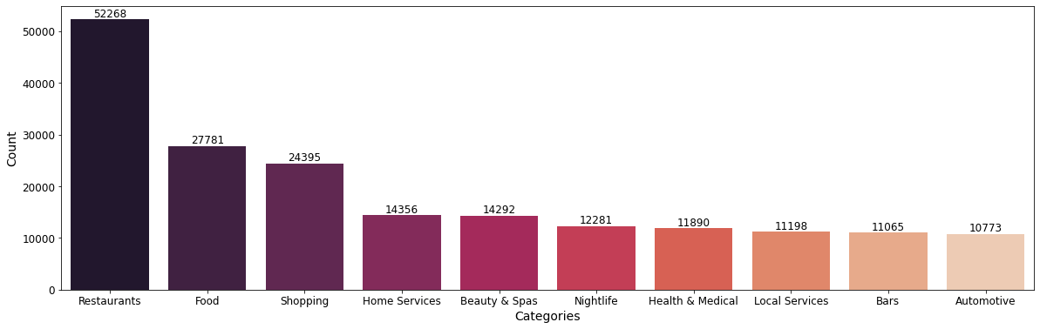
Exploratory Data Analysis (Business)
Top 10 Business Categories by Number of Businesses
Notes:
In the EDA process done on Yelp business dataset, we studied the distributions of businesses with respect to category and location. On this slide, we can see that restaurant and food categories have the highest number of unique businesses in our dataset.

Slide 17
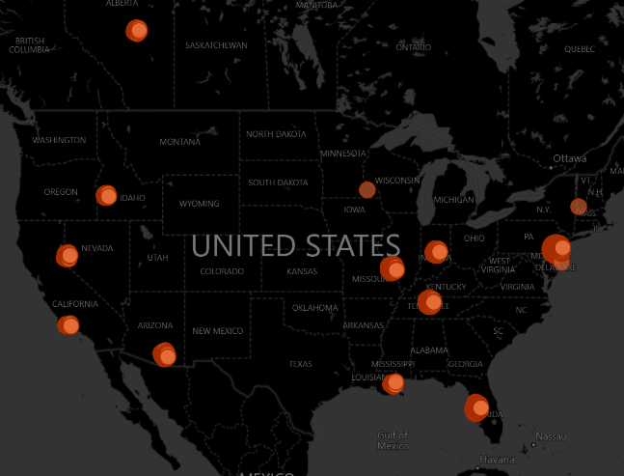
Exploratory Data Analysis (Business)
Most Popular States by Number of Businesses
23% Pennsylvania
18% Florida
<10% Other States
Notes:
And looking at this map, we see that Pennsylvania (PA) and Florida (FL) account for nearly 40% of total observations in our dataset. This Yelp dataset we obtained may be only a part of their complete data that they have released, so we are not seeing popular cities like New York, San Francisco, Seattle, etc.). From our exploration of the business dataset, we have reduced the data file to select approximately 14,000 open restaurants in Pennsylvania (PA) and Florida (FL) to focus on for this study.

Slide 18
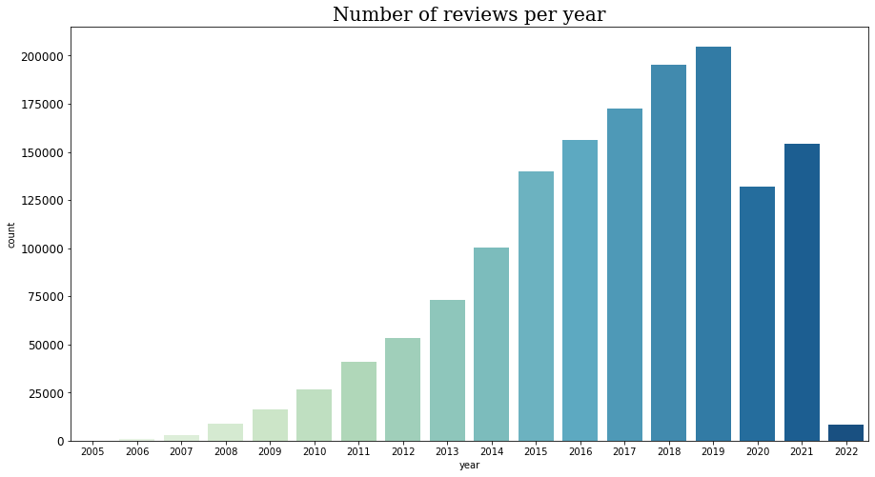
Exploratory Data Analysis (Review)
Distribution of Users’ Reviews
Notes:
Next, we want to examine the distribution of reviews over time. This dataset includes reviews of different businesses from 2005 to 2022. It is interesting to see that number of reviews used to increase steadily before 2019. 2020 suffered a deep plunge in Yelp reviews due to restaurants closing during the pandemic. The number of reviews for this year, 2022, only represent the first 3 months because this dataset is last updated in March 2022. We decided to use all the years for reviews in this project because a business rating is usually the weighted average of all users' ratings give to it over time.

Slide 19
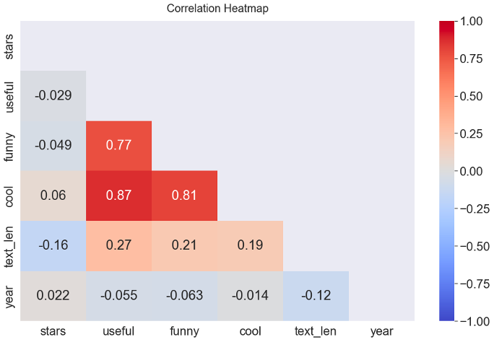
Exploratory Data Analysis (Review)
Review Correlation Analysis
High correlation among votes (funny, useful, cool)
Notes:
We also did the correlation analysis. This can help us remove highly correlated variables that may cause multi collinearity in our regression models. The heatmap shown on the slide shows that review votes (funny, useful, and cool) are highly correlated with each other. So we will not use these variables as features in our prediction models

Slide 20
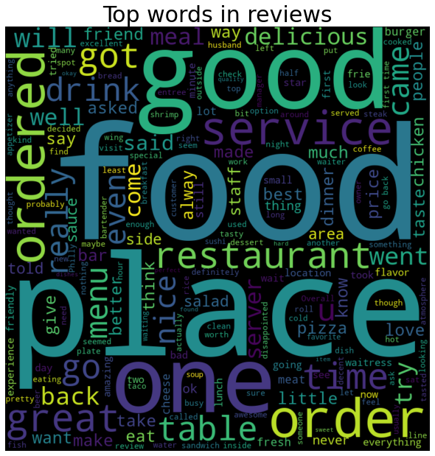
Exploratory Data Analysis (Review)
Top Words in Reviews
Notes:
Since the review data file has a large size, we generated this word cloud to get a good picture of all 7 million users’ reviews to know what most of them are about. Larger font indicates higher word appearance in all review texts. From the picture, we see that most reviews are about food or restaurant businesses. This finding also helped us define the focus of our study more clearly so that the size of our data could be significantly reduced for easier and faster processing.

Slide 21
Pre-Processing

Slide 22
Pre-Processing (Business)
Step Two
Join with Census income data on postal_code
Step One
Subset business
Step Three
Extract sub-attributes from “attributes” column and create dummies
Step Five
Step Four
Correlation analysis and feature selection
Correct the data type
12/6/2022
Yelp Restaurant Star Rating Prediction
22

Slide 23

Pre-Processing (Business)
Subset Restaurants
Business
Business Attributes + Income
Census Income
Transform
Business Attributes
Dropped Attributes
with High Correlation
Cleaned Dataset
Raw Dataset

Slide 24
Pre-Processing(Business)
Step One
Get all businesses where category contains 'Restaurants', is_open == 1, and in PA & FL states:
13,993 out of more than 150,000 businesses
Selected relevant features: business_id, business_name, city, state, postal_code, stars, categories, review_count, attributes
Step Two
Merge with Income Data on postal_code:
75 rows with no average income data => removed from the dataset
Treat non-numeric income data (income = '-' and income = 'N') as nulls (45 rows)
13,724 rows remained

Slide 25
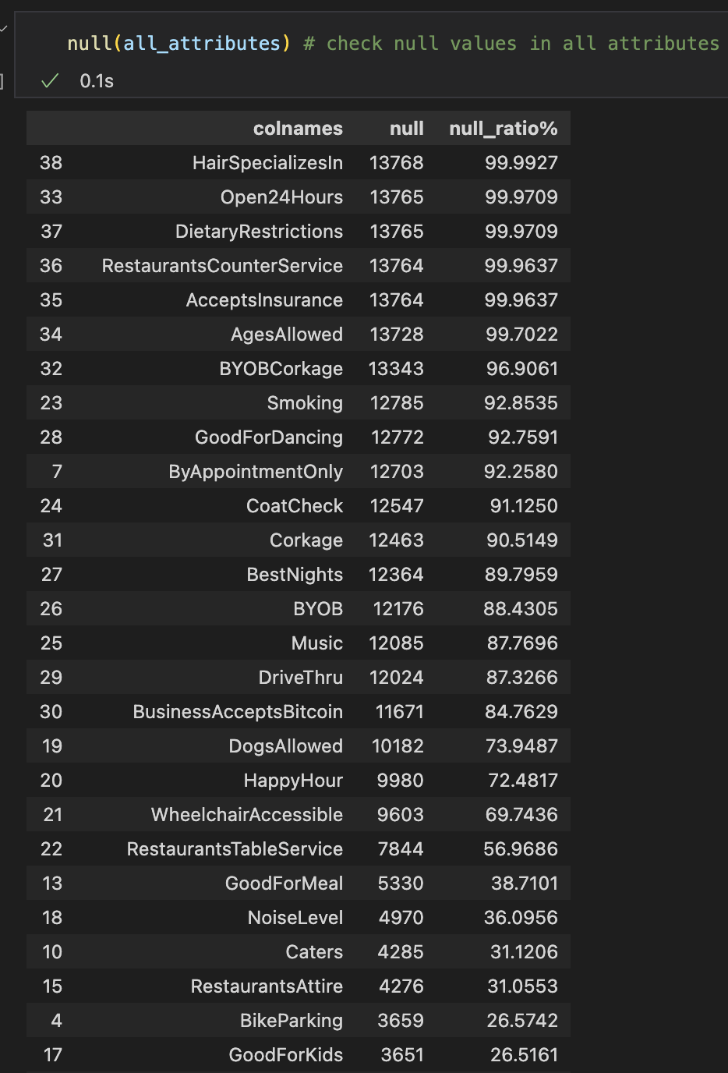
Pre-Processing(Business)
Step Three
All attributes are originally in string forms:
Convert strings to dictionary then to dataframe columns
Total of 39 attributes
Remove 20 attributes with more than 50% nulls

Slide 26
Pre-Processing(Business)
Step Three (continued)
Split attribute columns having string values
'BusinessParking': street, garage, validated, lot...
Convert categorical columns to dummies
['Alcohol', 'NoiseLevel', 'RestaurantsAttire', 'WiFi', 'RestaurantsPriceRange']; remove 1 category
After processing completes
There are a total of 45 attributes
'Ambience': casual, classy, trendy...
'GoodForMeal': dessert, lunch, dinner, breakfast...

Slide 27
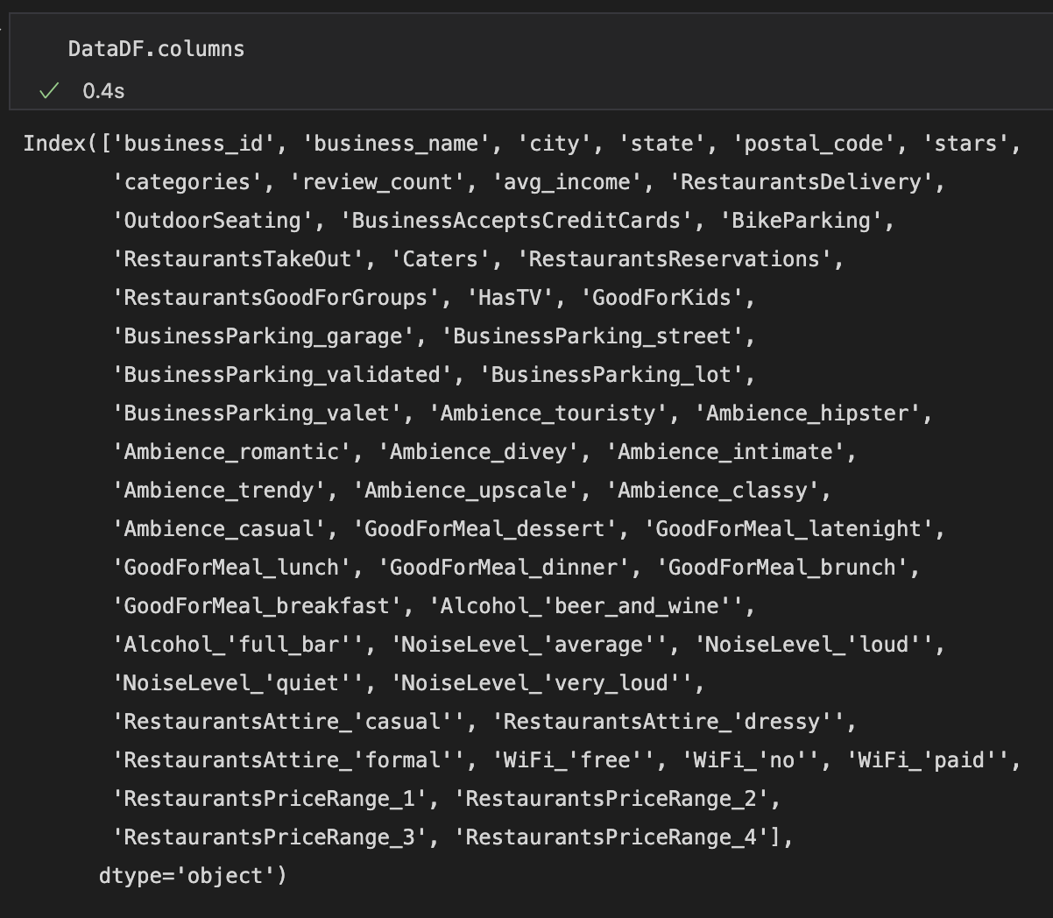
Pre-Processing(Business)
All features after step three

Slide 28
Pre-Processing(Business)
Step Four
Repeat on Attributes columns with sub-attributes
'True' and 'False': convert to Boolean values
'None', 'none', null, and nan => False
Final Processed dataset
No nulls in all columns
All attributes and categories have binary values (True and False or 0 and 1)

Slide 29
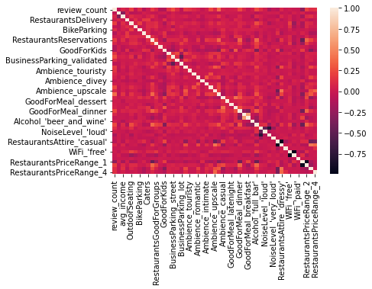
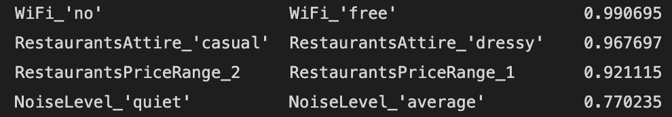
Pre-Processing(Business)
Step Five
Dropping columns that have absolute correlation coefficient more than 0.5
'GoodForMeal_breakfast'
"NoiseLevel_'quiet'"
"RestaurantsAttire_'dressy'"
"WiFi_'no'"
'RestaurantsPriceRange_2'
44 features left
Remove

Slide 30
Pre-Processing (Review)
Step Two
Text cleaning
Step One
Subset data:
Select reviews for chosen business IDs
Step Three
Sentiment analysis
Step Five
Step Four
Merge with business dataset
Combine polarity scores
12/6/2022
Yelp Restaurant Star Rating Prediction
30

Slide 31


Pre-Processing (Review)
Subset Restaurants
Review
Merge with Business Attributes + Income
User Review Dataset
Text Cleaning
Sentiment Analysis
Final Dataset
Convert to Lowercase
Remove Numbers, Punctuation, Stop Words, URL
Convert Contraction Expression to Formal Auxiliary Verbs
Word Tokenization
Lemmatization
Polarity Scores
Positive
Negative
Neutral
Notes:
For review dataset, the free text feedback are messy with lots of notices.
To make it easier for the computer to analyze human text, we have to clean the text (eg: remove numbers, punctuations, converting to lowercase)
One thing to note that there are a lot of contraction expression

Slide 32
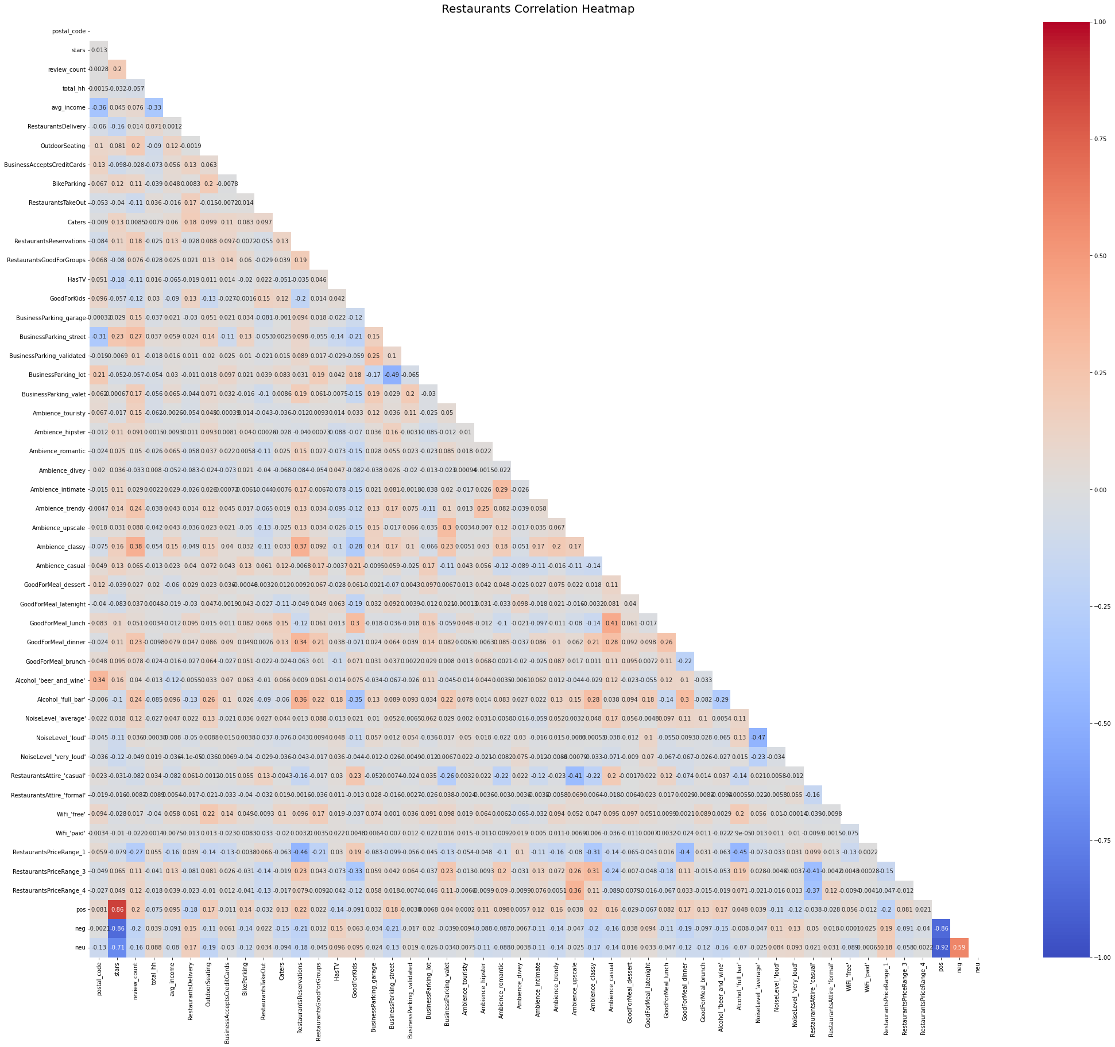

Slide 33
Text Cleaning
Text WITHOUT Preprocessing | Text WITH Preprocessing
If you decide to eat here, just be aware it is going to take about 2 hours from beginning to end. We have tried it multiple times, because I want to like it! I have been to it's other locations in NJ and never had a bad experience. \n\nThe food is good, but it takes a very long time to come out. The waitstaff is very young, but usually pleasant. We have just had too many experiences where we spent way too long waiting. We usually opt for another diner or restaurant on the weekends, in order to be done quicker. | decide eat aware going take hour beginning end tried multiple time want like location nj never bad experience food good take long time come waitstaff young usually pleasant many experience spent way long waiting usually opt another diner restaurant weekend order done quicker

Slide 34
Pre-Processing(Review)
Step three
Use Sentiment Intensity Analyzer to analyze the text and receive a positive, negative, neutral, and compound sentiment score
business_id | review_id | neg | neu | pos | compound
XQfwVwDr-v0ZS3_CbbE5Xw | KU_O5udG6zpxOg-VcAEodg | 0.0 | 0.747 | 0.253 | 0.8968
kxX2SOes4o-D3ZQBkiMRfA | AqPFMleE6RsU23_auESxiA | 0.0 | 0.441 | 0.559 | 0.9652
BVndHaLihEYbr76Z0CMEGw | OAhBYw8IQ6wlfw1owXWRWw | 0.0 | 0.377 | 0.623 | 0.9477
YtSqYv1Q_pOltsVPSx54SA | oyaMhzBSwfGgemSGuZCdwQ | 0.0 | 0.625 | 0.375 | 0.8860
x4XdNhp0Xn8lOivzc77J-g | G_5UczbCBJriUAbxz3J7Tw | 0.0 | 0.361 | 0.639 | 0.8910

Slide 35
Pre-Processing(Review)
Step Four
use the average of each sentiment score (positive, negative, and neutral) for selected business IDs
business_id | pos | neg | neu
-0TffRSXXIlBYVbb5AwfTg | 0.382047 | 0.032990 | 0.584970
-1B9pP_CrRBJYPICE5WbRA | 0.344671 | 0.051338 | 0.604000
-2YZIUArmrIMVVBi8CT47w | 0.389382 | 0.030353 | 0.580265
-361Hc0tlxSYdrH_C3OgzA | 0.315263 | 0.077316 | 0.607434
-3IOd5YntpkbK6RwT3HYtA | 0.317351 | 0.068261 | 0.614404

Slide 36
Pre-Processing(Review)
Step Five
merge the processed review dataset with final business dataset
47 features total

Slide 37
Models & Evaluations

Slide 38
Feature Sets
47 features
All Features
Reduced Features
Principal Component Analysis
Selected 5 to 7 features
Selected 30 Components
Notes:
In the modeling, we prepared for three datasets
All features included the features we discussed previously (business attributes, income, and sentiment scores)
There are a total of 47 features
To improve the model performance, we also created two datasets using feature importance and PCA algorithms to find the important features – see if can increase performance.

Slide 39
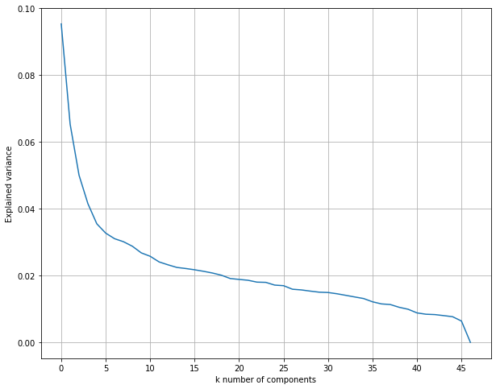
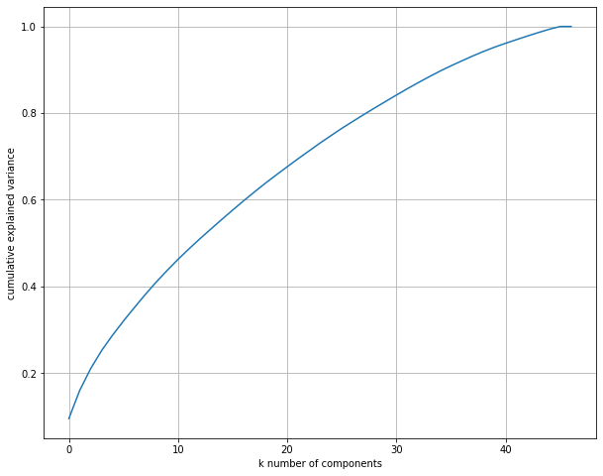
PCA

Slide 40
Algorithms
Decision Tree Regression
Random Forest Regression
Gradient Boosting Regression
Neural Network Regression
Support Vector Regression
Notes:
Decision tree can help to evaluate options. It is excellent for helping choose between several courses of action. It provides a highly effective structure within which you can lay out options and investigate the possible outcomes of choosing those options. It’s outcome is also easy to understand.
Random forest produces good predictions that also can be understood easily. It can handle large datasets efficiently. For most time, The random forest algorithm provides a higher level of accuracy in predicting outcomes over the decision tree algorithm
gradient boosting relies on the intuition that the best possible next model, when combined with previous models, minimizes the overall prediction error.
Support vector tries to finds the “best” margin that separates the classes and this reduces the risk of error on the data, it can have different decision boundaries with different weights that are near the optimal point.

Slide 41



Other Techniques
K-fold Cross Validation
Hyperparameter Tuning
Clustering
Notes:
We also applied different statistical techniques to determine the effectiveness of the models using k-fold cross validation and clustering .
We found out that the performance after applying these techniques is not as well as the original models.
We also wanted to find out the best parameters that can help us improving the model performance using grid search.
And the result we got is the exactly the same as the default parameters, that’s why we built all our models using the default parameters

Slide 42
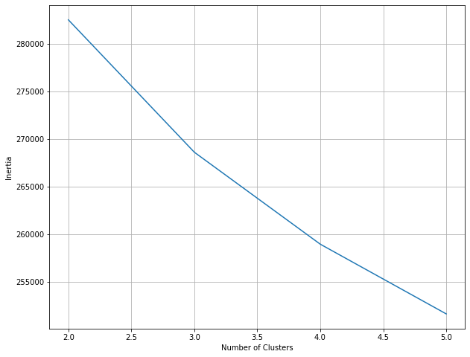
What else?
K-fold Cross Validation
Hyperparameter Tuning
Apply to the model with the best performance
{'learning_rate': 0.1, 'max_depth': 3, 'n_estimators': 100, 'subsample': 1.0} = 83.6%
Clustering

Slide 43
Evaluation Summary

Slide 44
Evaluation Summary
Gradient Boosting All Features - Highest Performance

Slide 45
Evaluation Summary
Decision Tree Performance is Unstable.

Slide 46
Evaluation Summary
Models | Datasets | K-fold Score | MSE | RMSE | R Squared
Decision Tree | All Features | 0.6440 | 0.1520 | 0.3899 | 0.6610
Gradient Boosting | All Features | 0.8361 | 0.0731 | 0.2703 | 0.8371
Neural Network | All Features | 0.7321 | 0.1226 | 0.3502 | 0.7266
Random Forest | All Features | 0.8257 | 0.0766 | 0.2768 | 0.8291
SVR | All Features | 0.8042 | 0.0843 | 0.2903 | 0.8121
Decision Tree | PCA | 0.5045 | 0.2261 | 0.4755 | 0.4960
Gradient Boosting | PCA | 0.7805 | 0.0954 | 0.3088 | 0.7874
Neutral Network | PCA | 0.7171 | 0.1114 | 0.3338 | 0.7515
Random Forest | PCA | 0.7693 | 0.1041 | 0.3226 | 0.7679
SVR | PCA | 0.7915 | 0.0909 | 0.3016 | 0.7972
Decision Tree | Reduced Features | 0.8097 | 0.0837 | 0.2893 | 0.8133
Gradient Boosting | Reduced Features | 0.8219 | 0.0793 | 0.2815 | 0.8233
Random Forest | Reduced Features | 0.7992 | 0.0890 | 0.2983 | 0.8017

Slide 47
Discussion & Conclusion

Slide 48

Discussion and Conclusion
Methodological Contributions
Limitations
Future projects
Domain Knowledge

Slide 49
Domain Knowledge / Business Insights
Sentiment Scores, Review Counts, Business Attributes
Important in influencing Business Star Rating
Encourage User to Leave Review to understand Customers’ Opinions & Expression
Give Promotions or Referral Program
Alcohol Full Bar is shown as one of the most important features in Business Attributes

Slide 50
Methodological Contributions
Handling Dataset
Text Processing
Statistical Techniques
Store file as a list of dictionaries in the memory
Subset data
Split attributes
Time Consuming
Contraction Expressions increase processing run time
Does not meet expectation
Generate lower performance
PCA
Feature Selection
K-fold Cross Validation
Clustering

Slide 51
Limitations and Future Work
Limitation
Only for Restaurant
Future Work
Solve the vectorization problems
Fail to Vectorize Text (Memory Error)
Apply more dataset

Slide 52
Q&A

Slide 53
THANK YOU

